Slide 1

HELP BE THE REASON SOMEONE SMILES TODAY

Slide 2
TABLE OF CONTENTS
00
01
02
Our Team
Problem Statement
Mission Statement
03
04
05
Our Process
Revenue Model
Prototype

Slide 3
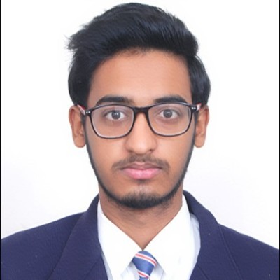
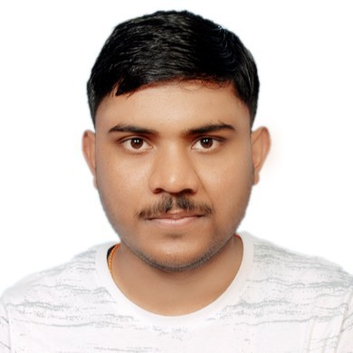
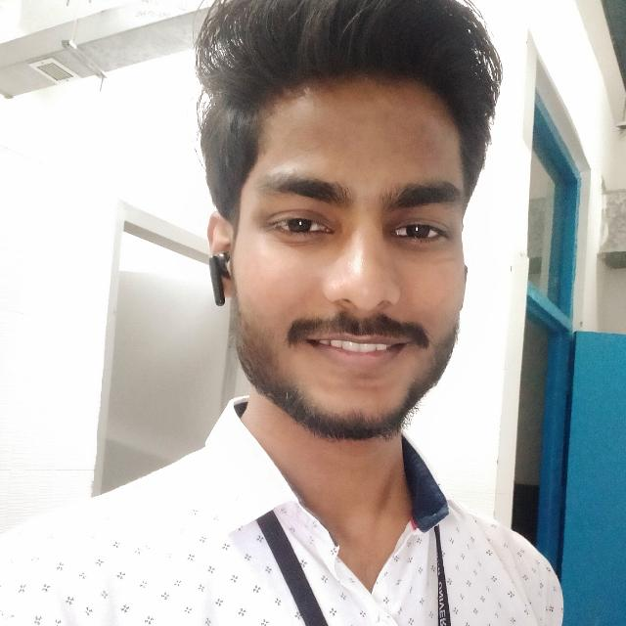
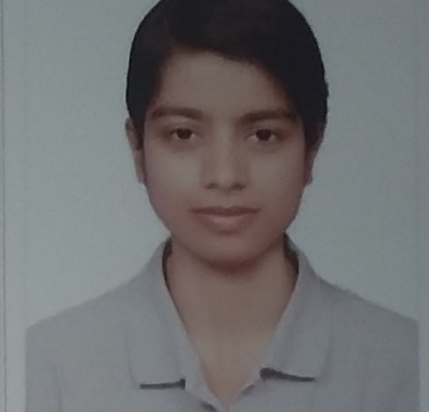
OUR TEAM
Shivam Gupta
Priyanshu Saw
Sangam Suman
Nancy

Slide 4

PROBLEM STATEMENT
01
NGO faces many allegations considering the inappropriate use of money & often don't have regular audits.

Slide 5

PROBLEM VS. SOLUTION
Problem
Solution
Many people in need struggle to find the right kind of help, while NGOs often operate in discretion and lack resources.
A central platform that unites all NGOs under one roof, enabling them to collaborate and share resources in a transparent way.

Slide 6

MISSION STATEMENT
02
Our mission is to create a centralized platform to build trust, promote transparency, and improve quality of life.

Slide 7

OUR PROCESS
03
NGO's
People
NGO's would register themselves to the platform
Philanthropists
Matching Algorithm
Record
Connecting on type of assistance & Location
Immutable blockchain based Record Generated

Slide 8
04
FINANCIAL PLAN

Slide 9
Revenue Model
Commission Based
Advertisement Based
Data Based
Commission Based
Advertisements of relevant products or services to people who are looking for assistance
A commission fee will be charged for every donation given through our platform.
This will be a very small nearly 0.5%.
Collected data can be used to provide insights and analytics to NGOs or other organizations that are interested in the NGO sector.

Slide 10




GROWTH & PROMOTION
LINKEDIN
INSTAGRAM
WEBSITE
WHATSAPP

Slide 11

PREDICTED GROWTH
User participation
Due to the trust buildup there is going to be exponential growth of contributors.
NGO's Impact
Due to increased transparency the impact would be enormous.

Slide 12
05
PROTOTYPE DEMO

Slide 13
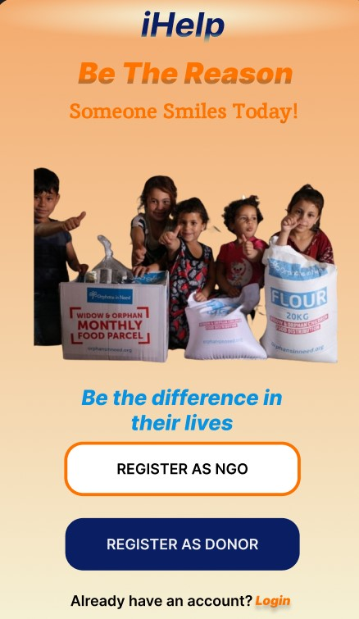
PHONE MOCKUP

Slide 14

Check Out the prototype

Slide 15
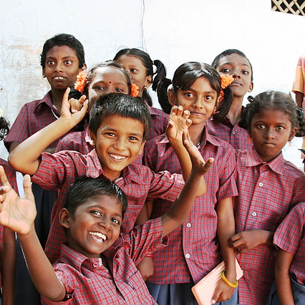
CONCLUSIONS
User-friendly interface for people in need to search and contact NGOs.
Easier access to the right kind of help for those in need
Secure and centralized database of NGOs and their services.
Resource-sharing platform for NGOs
This Photo by Unknown author is licensed under CC BY-SA.
We invite all NGOs and stakeholders to join us and be part of this initiative towards a better, more connected world.

Slide 16
RESOURCES USED :
https://www.clearias.com/non-governmental-organizations-ngos-recent-issues/
https://ngodarpan.gov.in/index.php/home/statewise
https://www.weforum.org/agenda/2021/07/blockchain-for-government-systems-anti-corruption/

Slide 17
Thanks!
Together, we can make a real difference in the lives of those who need it most.
​
​

